Slide 1
SOUTH MOUNTAIN DISTRICT LIFE TO EAGLE

Slide 2
LIFE to EAGLE AGENDA
Welcome / Introductions
Eagle Rank and Service Project Requirements
Eagle Project Workbook
Getting Project Approval – Troop and District
Eagle Fundraising Application
Eagle Scout Application
Reference Letters
South Mountain Life to Eagle Procedural Items

Slide 3
MINSI TRAILS and SOUTH MOUNTAIN DISTRICT CONTACTS

Slide 4
South Mountain District Eagle Advancement Contact Information Drew Draper – Advancement Chair 610-866-7875 acdraper31@rcn.com Michael Caffrey – Eagle Scout Chair 610-295-8816 mikecee1062@yahoo.com (preferred)
Notes:
Contact information for questions you may have concerning advancement

Slide 5
Minsi Trails Council Service Center 991 Postal Road, Allentown, PA 18109 Council Registrar Stephanie Miller 610-465-8569 Stephanie.Miller@scouting.org Eagle Scout Fund Raising Approval Arby Beisel Senior District Executive 610-465-8558 Russell.Beisel@scouting.org
Notes:
Mr. Chase is the Minsi Trails Council Registrar and processes the Eagle Applications. All completed Eagle Applications including completed Eagle Workbook are delivered to Mr. Chase for Application and Merit Badge approval. Please call him to set up a date and time
to submit your application.
Fund Raising for Eagle projects – contact Arby Beisel

Slide 6
REQUIREMENTS

Slide 7
Service Project Requirement
There are seven (7) requirements to attain the rank of Eagle Scout. Below is a Summary of those requirements, the official requirements can be found at the following web address:
https://www.scouting.org/scoutsource/BoyScouts/AdvancementandAwards/eagle.aspx
Eagle Rank Requirements Summary
Be active in your troop, team, crew, or ship for a period of at least six months after you have achieved the rank of Life Scout.
Demonstrate that you live by the principles of the Scout Oath and Scout Law in your daily life.
Earn a total of 21 merit badges (13 are mandatory).
While a Life Scout, serve actively in your unit for a period of six months in one or more of a position of responsibility (see web page for approved positions).
While a Life Scout, plan, develop, and give leadership to others in a service project helpful to any religious institution, any school, or your community. (The project must benefit an organization other than Boy Scouting.) A project proposal must be approved by the organization benefiting from the effort, your unit leader and unit committee, and the council or district before you start. You must use the Eagle Scout Service Project Workbook, BSA publication No. 512-927, in meeting this requirement. (To learn more about the Eagle Scout service project, see the Guide to Advancement, topics 9.0.2.0 through 9.0.2.15.)
Take part in a unit leader conference.
Successfully complete an Eagle Scout board of review.
Notes:
Eagle Scout Service Project does not have to be last requirement for Eagle after all merit badges are completed. Project approval may take may take many weeks or even months if you need to present your proposed project to different people. You can not start working on the project or getting approvals until you are a Life Scout, but may get an idea of a possible project before hand.

Slide 8
Service Project Requirement
Eagle Scout Requirement 5
While a Life Scout, plan, develop, and give leadership to others in a service project…
… helpful to any religious institution, any school, or your community. (The project must benefit an organization other than Boy Scouting.)
A project proposal must be approved by the organization benefiting from the effort, your unit leader and unit committee, and the council or district before you start. You must use the Eagle Scout Service Project Workbook, No. 512-927, in meeting this requirement.
Notes:
Eagle Scout Service Project does not have to be last requirement for Eagle after all merit badges are completed. Project approval may take may take many weeks or even months if you need to present your proposed project to different people. You can not start working on the project or getting approvals until you are a Life Scout, but may get an idea of a possible project before hand.

Slide 9
TRAIL TO EAGLE SERVICE PROJECTS

Slide 10
Minsi Trails Council Website
WWW.MINSITRAILS.ORG
Notes:
Each Scout should check for the most current information on the Minsi trails Council website before completing the Eagle Scout Project Workbook or Eagle Scout Application.

Slide 11
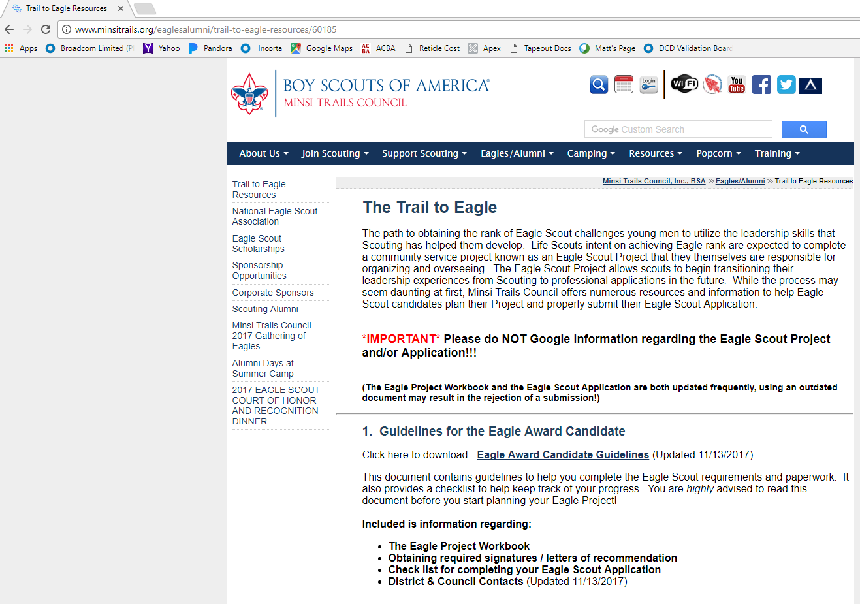
Minsi Trails Council Website
Notes:
Each Scout should check for the most current information on the Minsi trails Council website before completing the Eagle Scout Project Workbook or Eagle Scout Application.

Slide 12
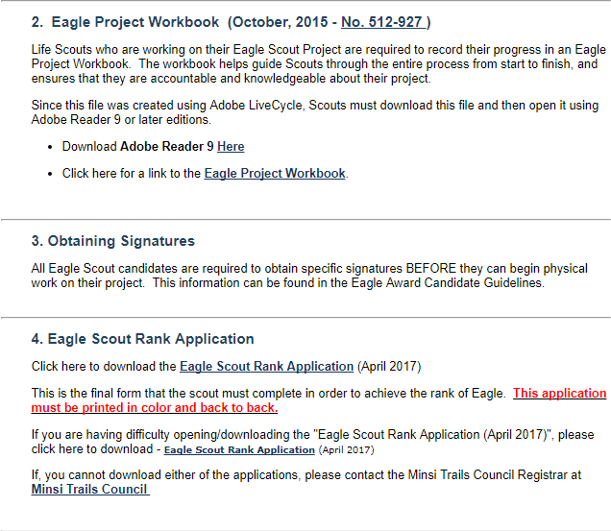
Minsi Trails Council Website
Notes:
Each Scout should check for the most current information on the Minsi trails Council website before completing the Eagle Scout Project Workbook or Eagle Scout Application.

Slide 13
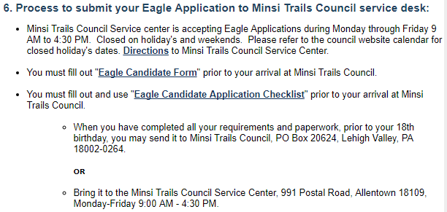
Minsi Trails Council Website
New Name – “Eagle Application Submission Form”
Notes:
Each Scout should check for the most current information on the Minsi trails Council website before completing the Eagle Scout Project Workbook or Eagle Scout Application.

Slide 14
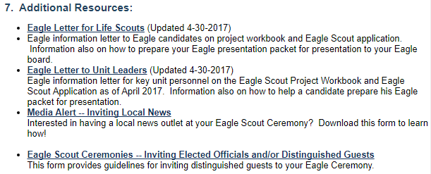
Minsi Trails Council Website
Notes:
Each Scout should check for the most current information on the Minsi trails Council website before completing the Eagle Scout Project Workbook or Eagle Scout Application.

Slide 15
Project Workbook

Slide 16
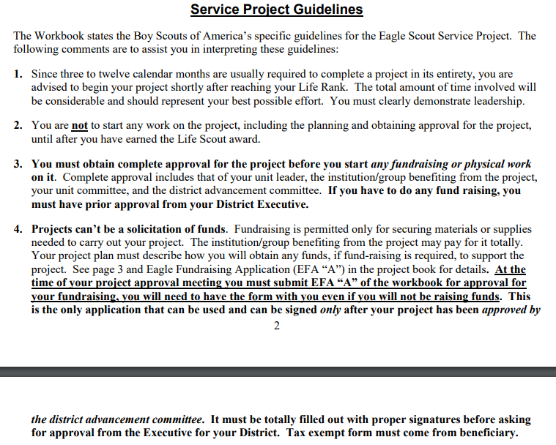
Key Guidelines

Slide 17
Key Guidelines (con’t.)
KEY TAKE AWAYS:
All hours you work on a project including Beneficiary Communications, Project Planning, Project Write Up, Project Research and Purchasing should be included in your Service Hours.
Final Project Report, with all Signatures, and Eagle Application with all merit badges completed and in Internet Advancement, on or before your 18th birthday.

Slide 18
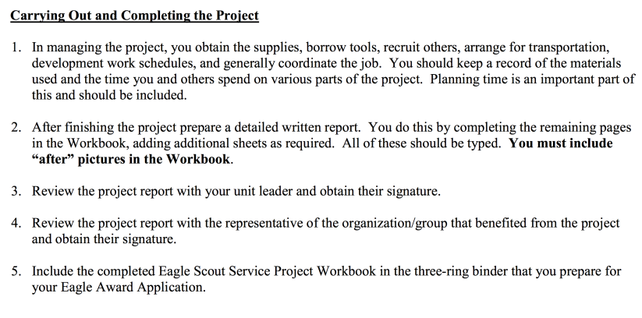
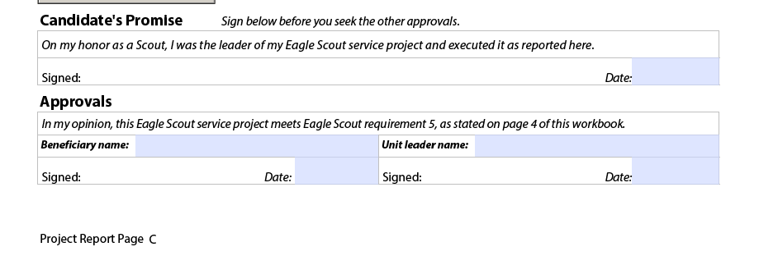
KEY TAKE AWAYS:
Once complete, you sign and date first. Then, obtain Beneficiary name/signature with date. IMPORTANT – This is your Date of Completion for your Application. Then, obtain Unit Leader name/signature.

Slide 19
Eagle Service Project Addtl. Help
1. All paperwork should be typed or neatly printed in ink. It is advisable to make copies of your paperwork and all forms on which to practice before filling out the final papers. It is also advisable to keep a copy of your completed information for future reference should something get lost. The Council keeps the original information until final approval is received from the National Eagle Service and will then return it to you.
2. Complete your “Eagle Scout Service Project Workbook” as described above and follow the directions as you go through the pages. Properly complete the Workbook as instructed while planning for and after completion of the project. Plan ahead – this new project process will take more time than projects completed in the past by Eagle candidates in your troop/crew.
3. When you have finished your project and all merit badge and troop leadership requirements for the Eagle Scout Award, complete the Eagle Award Application. We recommend you download this form from the Minsi Trails Council’s website. When doing so it has to be printed in color and back-to-back. This application must be the April 2017 printing. For references you must give person(s) name, complete address, including number and street, city/state/zip code. An e-mail address is required for all of your references – must be able to read them – and if they don’t have one indicate with “N/A.” You may not use girlfriends/ family members/current unit leaders or anyone under 18 years of age for “two other references” and if you don’t have a “Religious” affiliation you must provide total information on a parent or guardian again.
4. Check with your unit leader or unit advancement person to verify dates of badges earned. Your unit has access to your advancement records through Internet Advancement. If merit badges and/or rank advancements are not in the official council records when the application is received it will not be processed until documentation (Advancement Report) is received from the Troop/Crew. Blue cards are not documentation. Conflicting or missing dates will delay the application process.
5. You, the Eagle candidate are responsible for securing the recommendation letters from those you list in requirement 2. See instructions on bottom of page six (6). Letters will be sent to the District Eagle Board of Review Chairman.
KEY TAKE AWAYS:
Application printed 2 sided, in color.
References must have full addresses and an email (if applicable).
Troop specific software is not the official record, must be in INTERNET ADVANCEMENT

Slide 20
Eagle Service Project Addtl. Help
6. Signatures are required on the application and they must be dated. If your Troop/Crew leadership is not signing off on your Eagle application, they must notify the Council Registrar so he/she can process the application according to BSA policy at the time the application is received.
7. Submit your completed Eagle Application and completed Service Project Workbook to the Council Service Center for review and certification on or before your eighteenth birthday. Required materials to be included are:
• Presentation should be in a three-ring binder with “Eagle Application” as a title, your name, unit number and district on the front and if clever, a picture of your final project. Include Eagle Candidate Form (see #6 on website)
• Eagle Award Application neatly and completely filled out. It must be printed in color and two-sided (back-to-back).
• Your personal statement of life ambition and purpose. This is located in Bold Print under the “Certification By Applicant” section of the application.
• Your completed Service Project Workbook.
• Accompanying support materials such as photographs, diagrams, etc.
8. After your application has been verified by the Council, you or your unit leader will be contacted by the Eagle board of review chairman of your District to schedule your Board of Review. In most cases, it will be within 30 days from submittal of application. When you come to the Board of Review you should be neat in appearance and in your uniform, with badges worn properly.
9. Upon the satisfactory completion of your Eagle Board of Review, your application will be signed and forwarded to the national Eagle Scout Service, who will screen the application to determine if it is in order. If so, you will then be certified as an Eagle Scout by the Eagle Scout Service on behalf of the National Council.
10. Please plan your Eagle Court of Honor at least 45 days past your Board of Review date. The national Eagle Scout Service must process your application and return it to Minsi Trails Council. We cannot guarantee the turnaround time of processing your application.

Slide 21
EAGLE PROJECT WORKBOOK

Slide 22
Project Workbook
Click on “Workbook”

Slide 23
Project Workbook
Workbook Sections
Project Proposal
Project Plan
Project Report
Project Fundraising Application
This approval is sought AFTER Project Proposal is approved by District
“Navigating the Eagle Scout Service Project” for Beneficiaries.
This must be discussed and a copy provided to Beneficiary BEFORE your Project Proposal District Approval. Beneficiary checks the Box before signing.

Slide 24
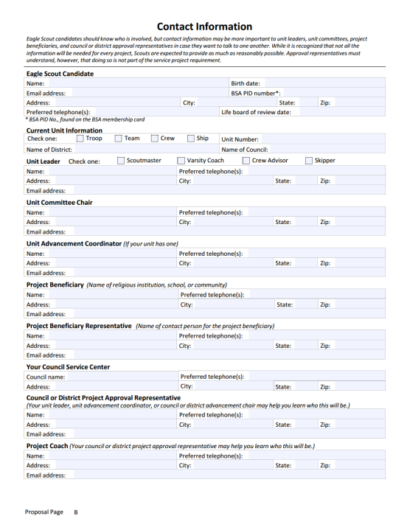
Project Proposal
Your name/Information
Your Unit’s Leadership
Beneficiary Main
Beneficiary Contact
Minsi Trails Council
Michael Caffrey
Coach - recommended
Notes:
This needs to be filled out completely.
A project coach Is strongly recommended. Each unit will determine who this may be.
We ask that you bring a copy of this along to your project proposal meeting that we can keep

Slide 25
Project Proposal
Notes:
Your project coach can assist you in this process

Slide 26
Project Proposal

Slide 27
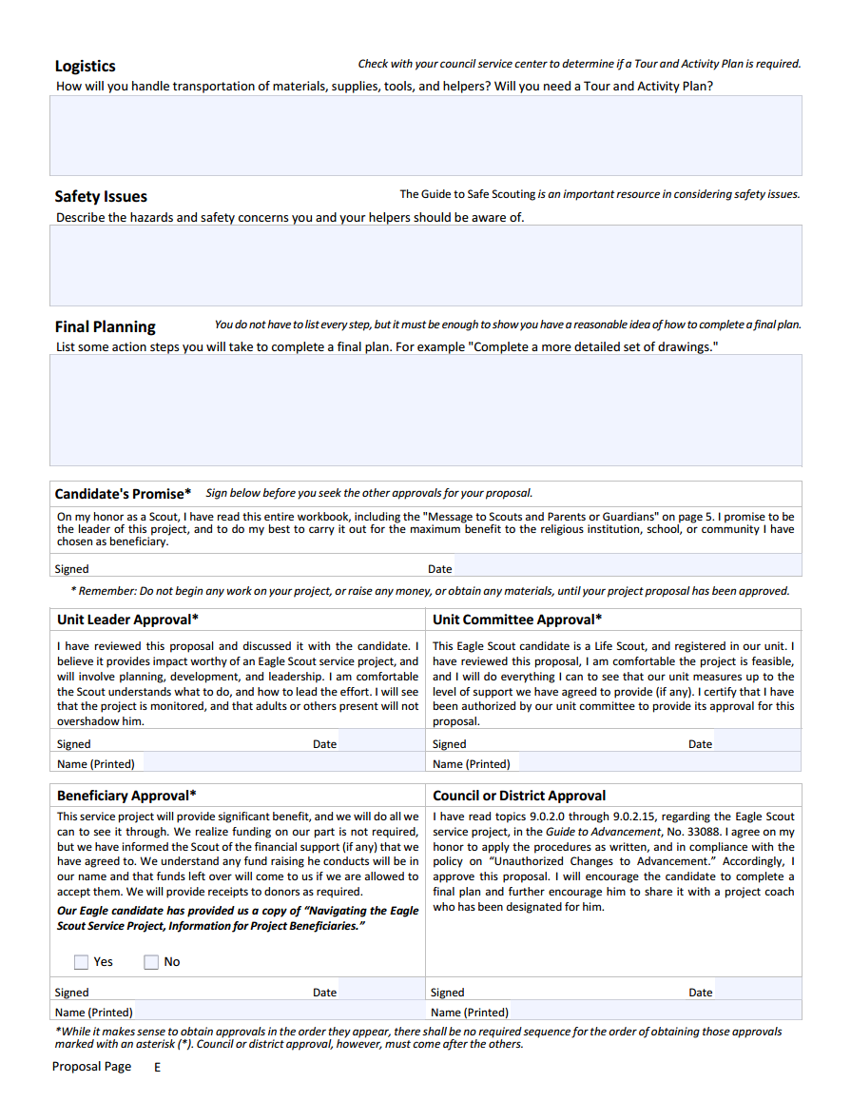
Project Proposal
Notes:
Be sure that your beneficiary receives a copy of the “Navigating the Eagle Scout Service Project” letter when signing your proposal.
When your proposal is written up and all signatures are obtained, excluding the district signature, you are ready to call and schedule a time to present your project.
We meet the 2nd Thursday of every month at East Hills Moravian Church.
If calls are received after the Sunday before the 2nd Thursday, there is no guarantee you will be able to be added and will be put on the schedule for the following month.
So please remember when your 18th birthday is and plan accordingly
Your coach, another adult from your troop, or a parent must accompany you to your approval meeting.
We will ask you to bring an extra copy of your proposal that we can keep.

Slide 28
Beneficiary Info
IMPORTANT: Review and leave a copy with Beneficiary Representative before they sign your project.
SUGGESTION: Add your name and contact information to the top of this page.

Slide 29
Beneficiary Info

Slide 30
Project Proposal Approval
When you have your Proposal ready for approval and have obtained the Unit Leader signature, Unit Committee signature and Beneficiary signature, and, at least 1 week prior to the 3rd Tuesday of the month … contact Mr. Caffrey at mikecee1062@yahoo.com (preferred) or 610-295-8816 to request an appointment.
When contacting via email, please be sure to copy a Unit Leader or parent to maintain 2 deep leadership.
An adult MUST accompany the Scout for the Project Approval once scheduled.
Bring a second copy of your Project Proposal to remain with the SMD Committee.
You will confirm that you have reviewed and provided a copy of the “Navigating the….Project” to the Beneficiary.
You must bring 2 copies of the fundraising form. (More in the next section)
If you plan to Fundraise, then the form needs to be filled out in its entirety and signed by Unit Leader and Beneficiary.
If you DO NOT plan to fundraise, fill out the “Eagle Scout Candidate” section and in the center section mark “No Fundraising required”.
Your project proposal should be in a 3 ring binder and is best if used with plastic inserts for ease of changes.
For special circumstances, alternate arrangements to meet can be made.

Slide 31
FUNDRAISING
Fundraising Info
$
Approval Appointment AFTER District Project Approval received by contacting South Mountain District Executive. CONTACT INFO:
Mr. Arby Beisel - Russell.Beisel@scouting.org

Slide 32
Fundraising Info

Slide 33
Fundraising Info

Slide 34
Project Plan
Comes after Project Proposal and District Approval. Breaks down your proposal into defined steps to complete the project in an efficient manner.
Helps give a better understanding of what is needed and when.

Slide 35
Project Report
Comes after Project is completed.
Gives a summary of how the Project progressed and how you exemplified Leadership of this project.
Should give a clear understanding to a person not involved with your project.

Slide 36
Project Report

Slide 37
Project Report

Slide 38
Project Report

Slide 39
EAGLE APPLICATION

Slide 41
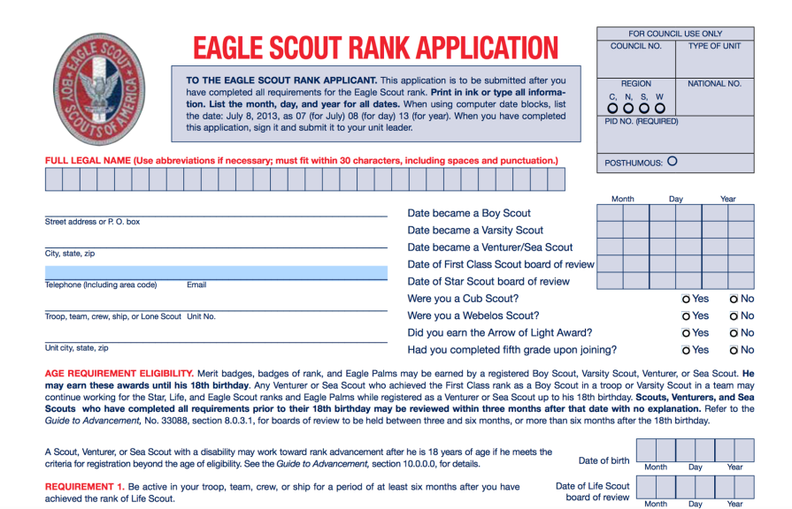
Application

Slide 42
Application
KEY TAKE AWAYS:
List parents/guardians but not required to write a letter. For others, please list name, address, phone and email (if not email address list as “NA”). You may use abbreviations in the addresses.
Check with the persons BEFORE mailing then a letter. Send letters when completing the Application.

Slide 43
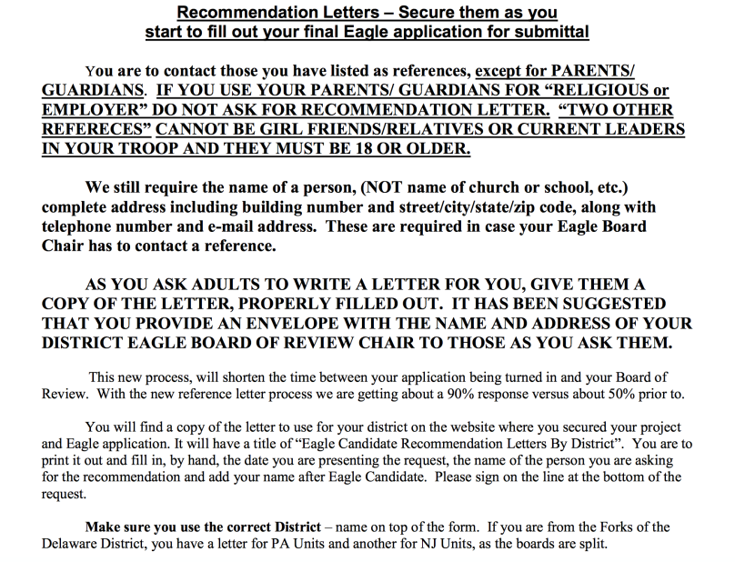
Application

Slide 44
Application
KEY TAKE AWAYS:
Ask your Unit Leader or Advancement Chair for a copy of your Member Summary from INTERNET ADVANCEMENT for the merit badge dates as registered with the BSA.
Don’t forget to list the UNIT NO. where you earned the merit badge.
You MUST cross out the merit badges in #7, #8 & #10 that you DID NOT use to complete this requirement. If using the Minsi Trails Workbook, the Macro should cross out automatically.

Slide 45
Application
KEY TAKE AWAYS:
Position cannot begin before the Date of Life Scout board of review from your Member Summary and must be at least 6 months in length. Must be from the approved list of positions.
Project name should include the name of the Beneficiary and what you did “remodeled, built, collected, etc…”
Date Project Finished must be the date that the Beneficiary signed off on your project from your Project Report.
Grand Total of Hours should match your Project Report.

Slide 46
Application
KEY TAKE AWAYS:
Unit Leader Conference date must be AFTER the Project Completion date.
Applicant Signature date must on or after Unit Leader conference date.
Unit Leader and Unit Committee Chair Signature dates must on or after Applicant Signature date.
BSA Local Council Verification signatures will be after the Board of Review.

Slide 47
Application
KEY TAKE AWAYS:
Requirement 7 signatures will be after the Board of Review with a minimum of 3 persons, at least 1 being on the SMD Eagle Committee.

Slide 48
Submitting the Eagle Application
New Name – “Eagle Application Submission Form”
KEY TAKE AWAYS:
The Applicant then turns in the complete binder w/ Application & the completed Candidate Form.
Council will review for accuracy of dates, etc… then will notify the SMD Eagle Chair the binder is ready for pick up. After allowing for Letters of Recommendation to be received, the Eagle Chair will email the Candidate, Unit Leader and Unit Committee Chair to schedule the next available Board of Review (3rd Tuesday night each month at East Hills Moravian Church, Bethlehem.
2 Committee Members from the Unit are required to sit in on the Board of Review. SM/ASM are invited to attend in a support role.
For special circumstances, alternate arrangements can be made.

Slide 49
Eagle Application Summary
REFERENCE LETTERS
Need at least three reference letters
Request from all people as on Eagle application (except parents/guardians)
Use form letter for South Mountain District (available on Minsi Trails website). Print, fill in blanks for each prospective recommender, and provide a stamped, pre addressed envelope addressed to the South Mountain District Eagle Chair.
Send out requests no more than 30 days before scout submits all paperwork into the Minsi Trails Council office.
SUBMITTAL OF EAGLE APPLICATION
To council office before 18th birthday
Obtain receipt from Council office
Fill out Eagle Application Checklist and form titled “Eagle Candidate Form”,
Submit to council office and allow up to 4 weeks before Board of Review
Application Front page in a 3 ring binder:
On the cover: your name, Troop/Crew #, South Mountain District, Title saying “Eagle Application” and a picture of your completed project (if you can).
Eagle Application form (in color, two sided)
Project Workbook including completed Project Report section and before and after pictures of the project
Include Fund Raising Application even if you did not have to use it.
COMMON APPLICATION ERRORS
All dates must be AFTER the date you joined Scouting.
If you crossed over from Cub Scouts, you most likely were NOT graduated from 5th grade.
Ensure your leadership dates begin AFTER your Life Rank Board of Review date and is at least 6 months in length.
Grand Total of Project Hours must match exactly with the hours in your Project Report.
Date Project Finished is the date that the Beneficiary signed the Project Report.
The Council checks dates using Internet Advancement. Request a copy of your Member Summary to ensure all dates align and all merit badges are listed with the correct date. This should be done BEFORE turning your Application/project in to the Council Office.

Slide 50
QUESTIONS?

